Slide 1
LINGERIE BIDS
SPRING/SUMMER 2023

Slide 2
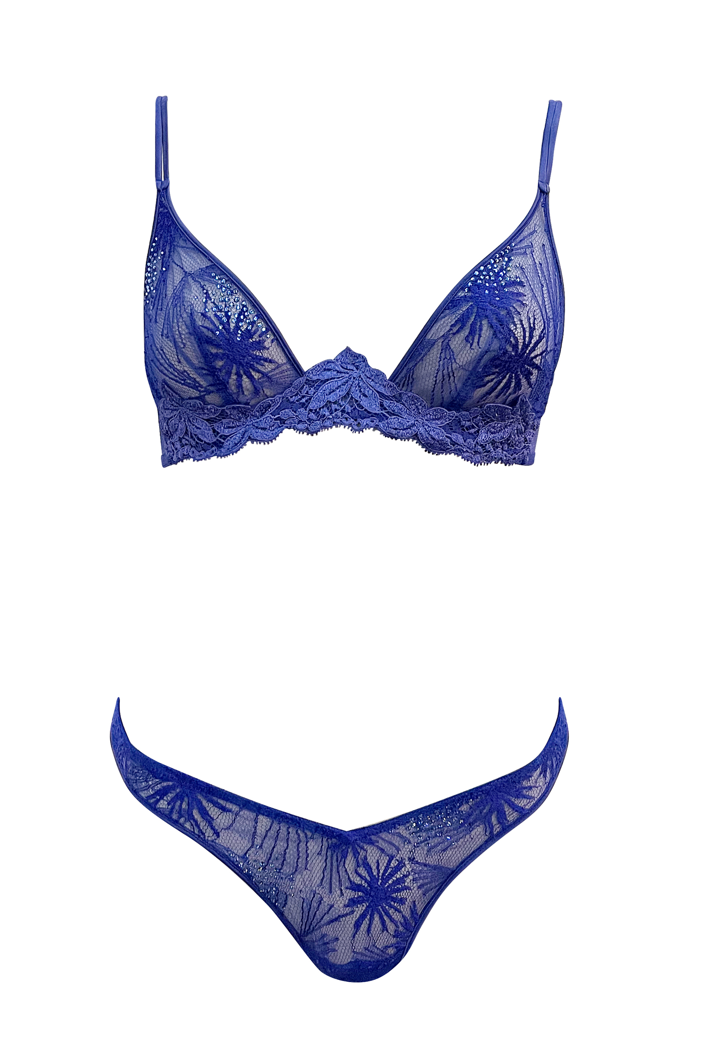
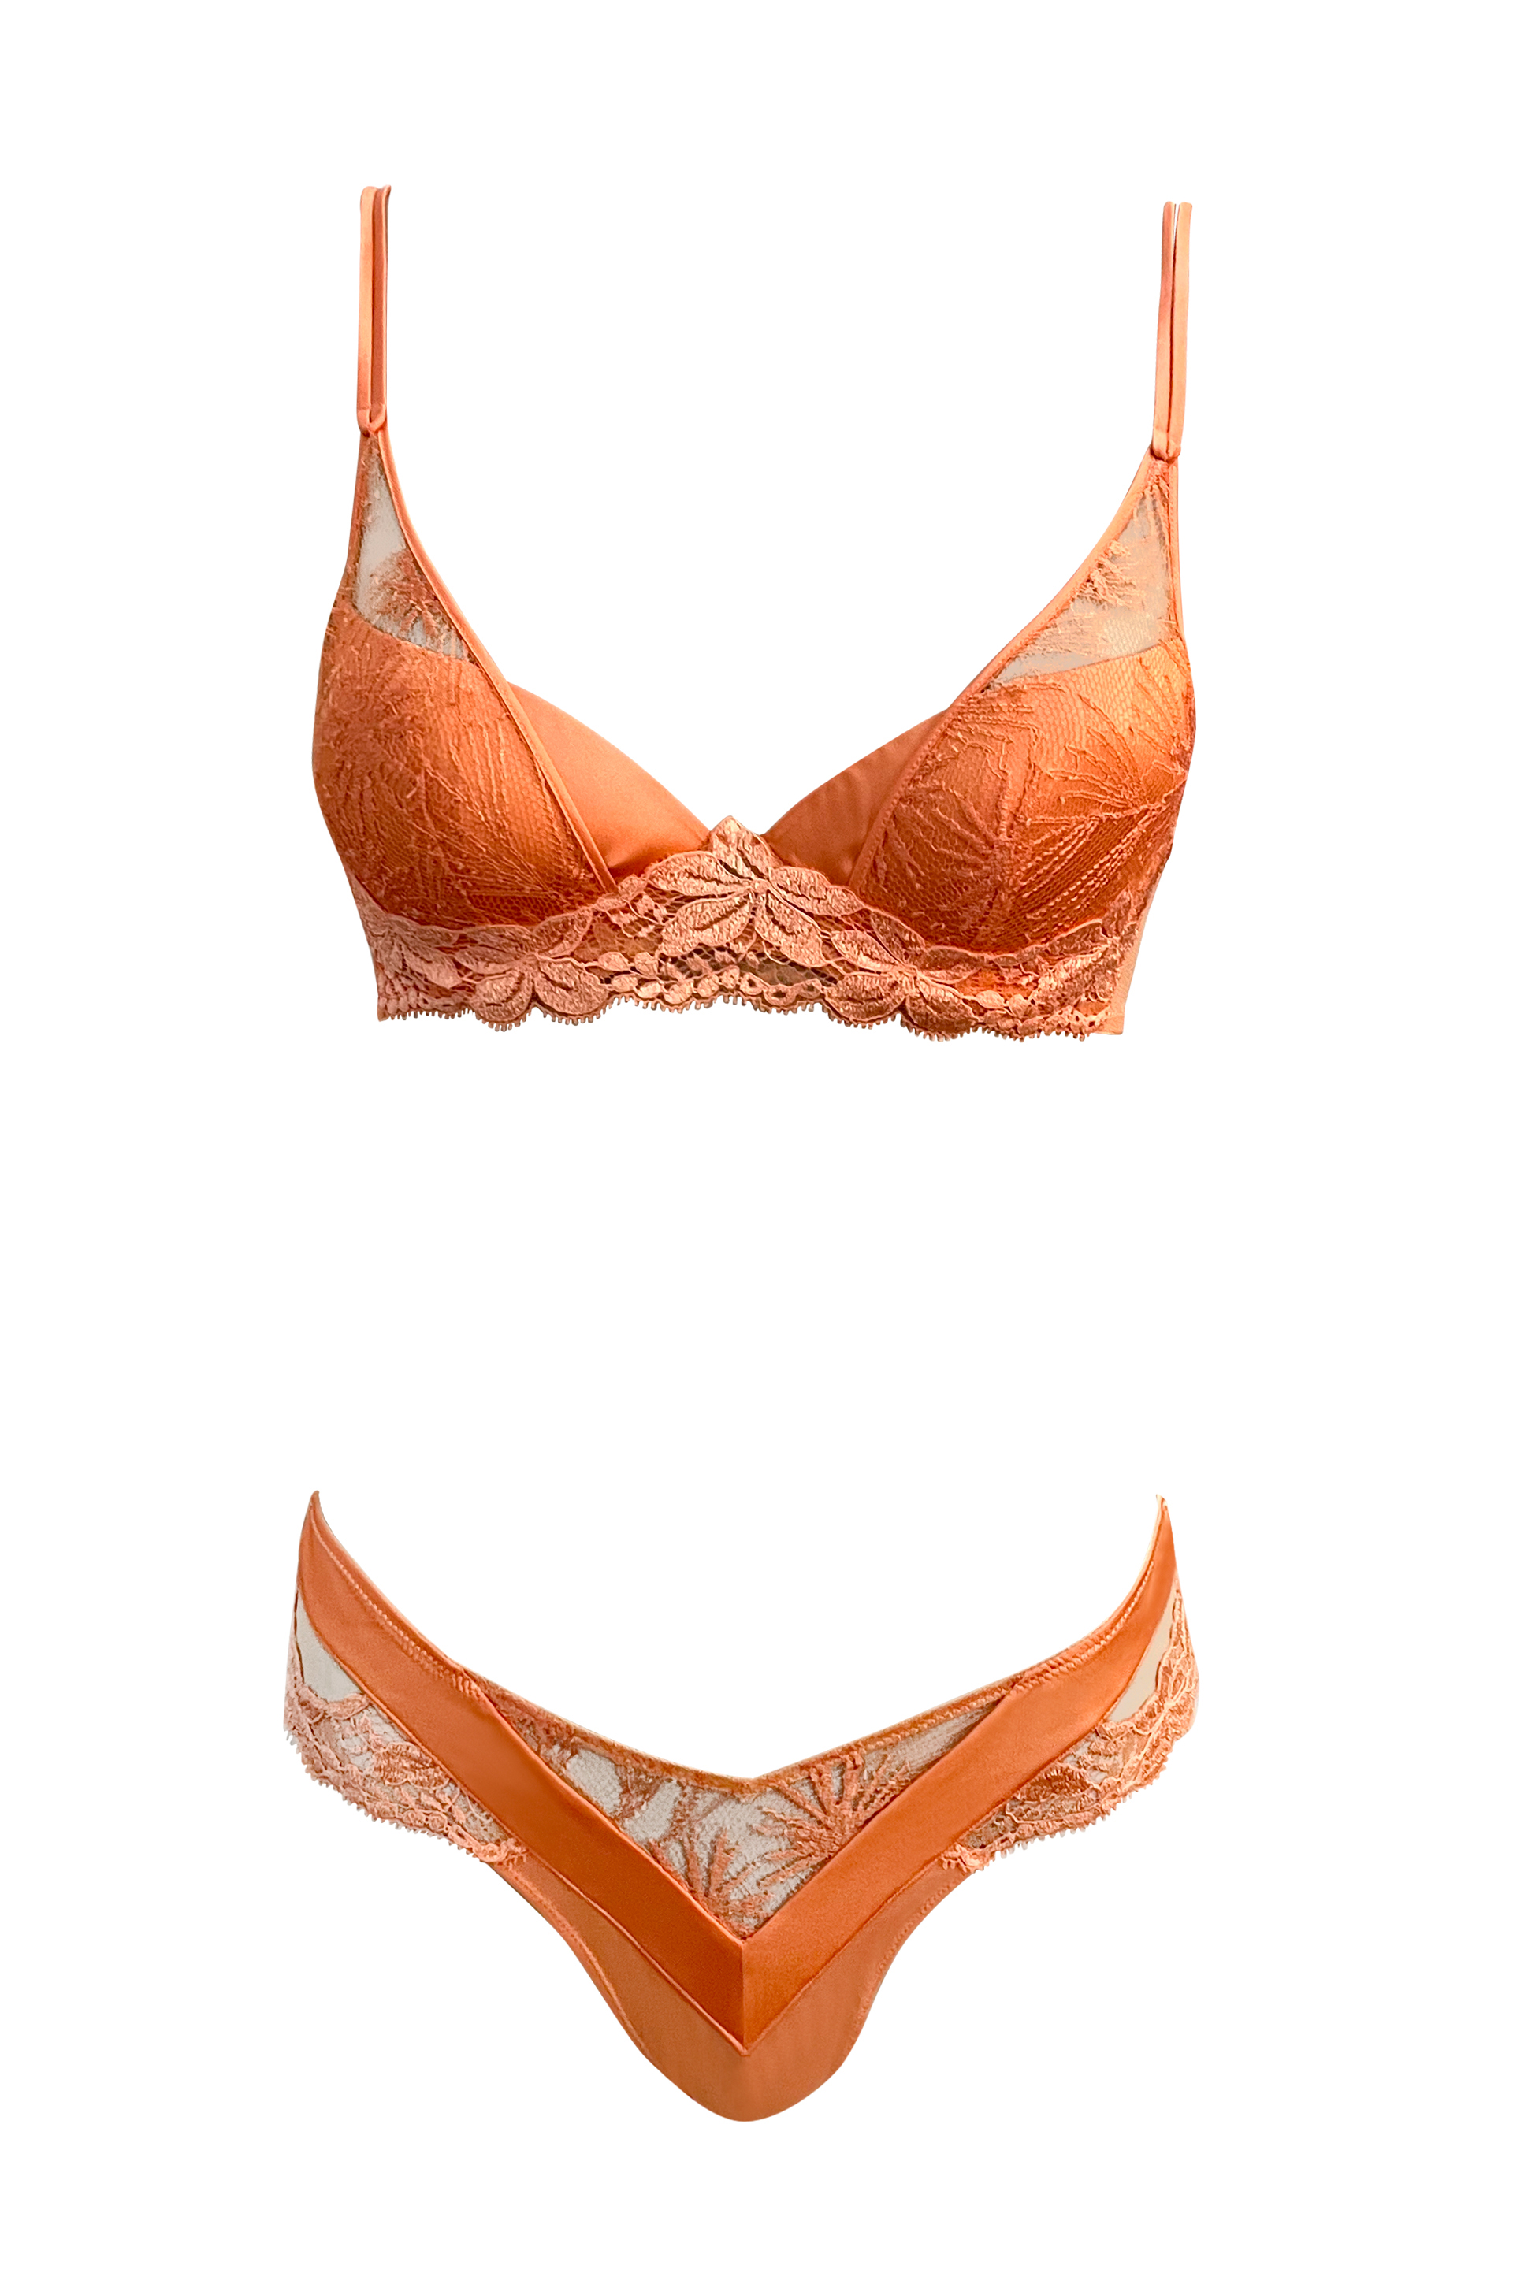
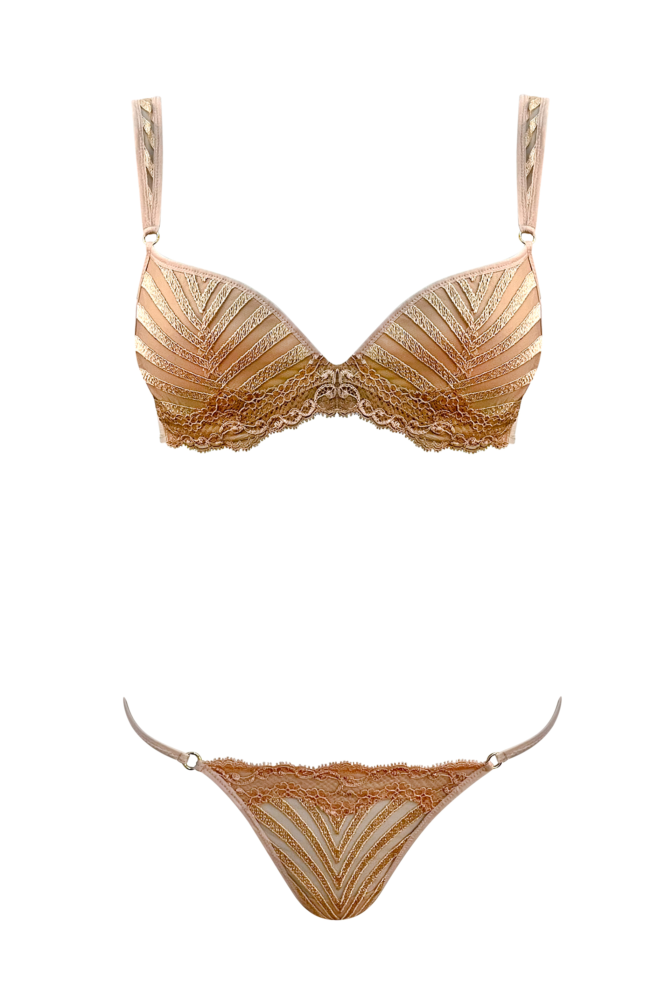
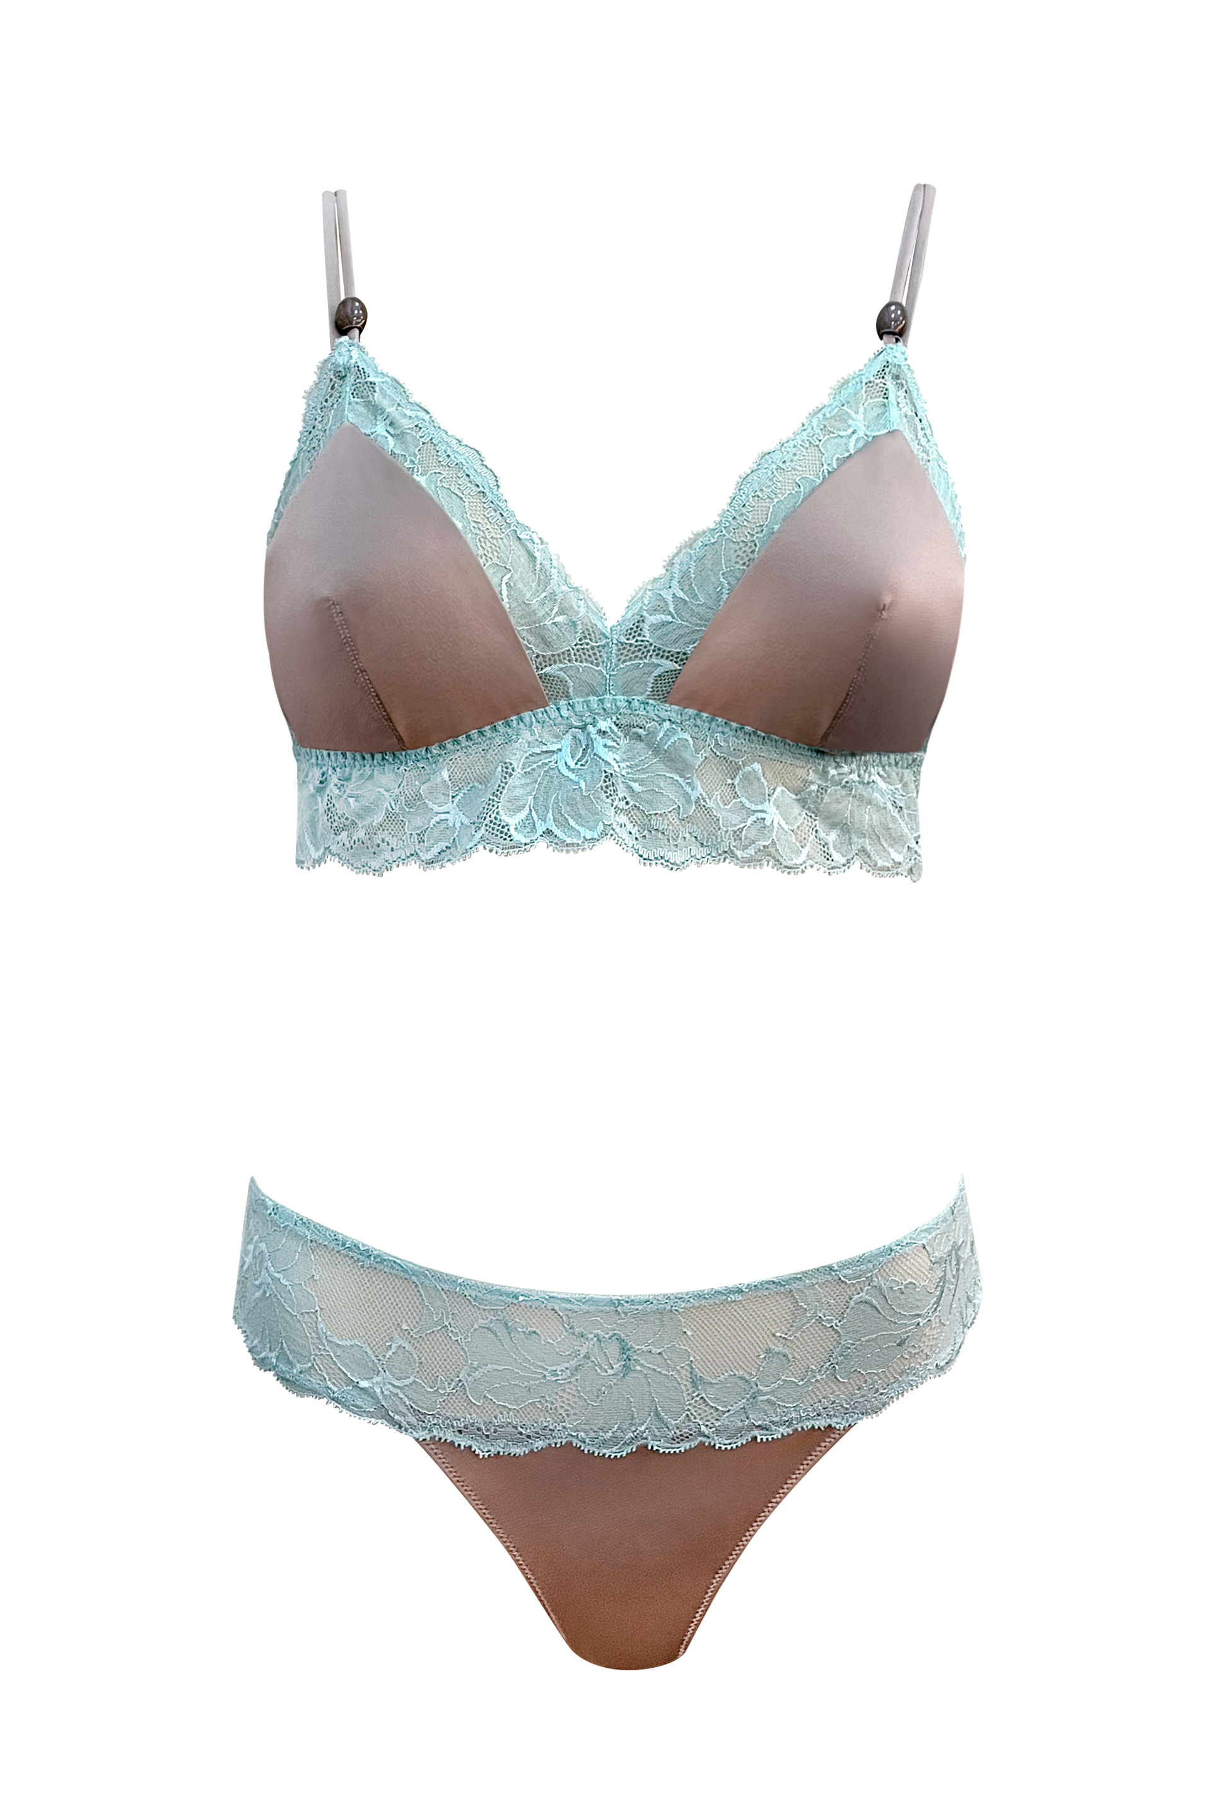
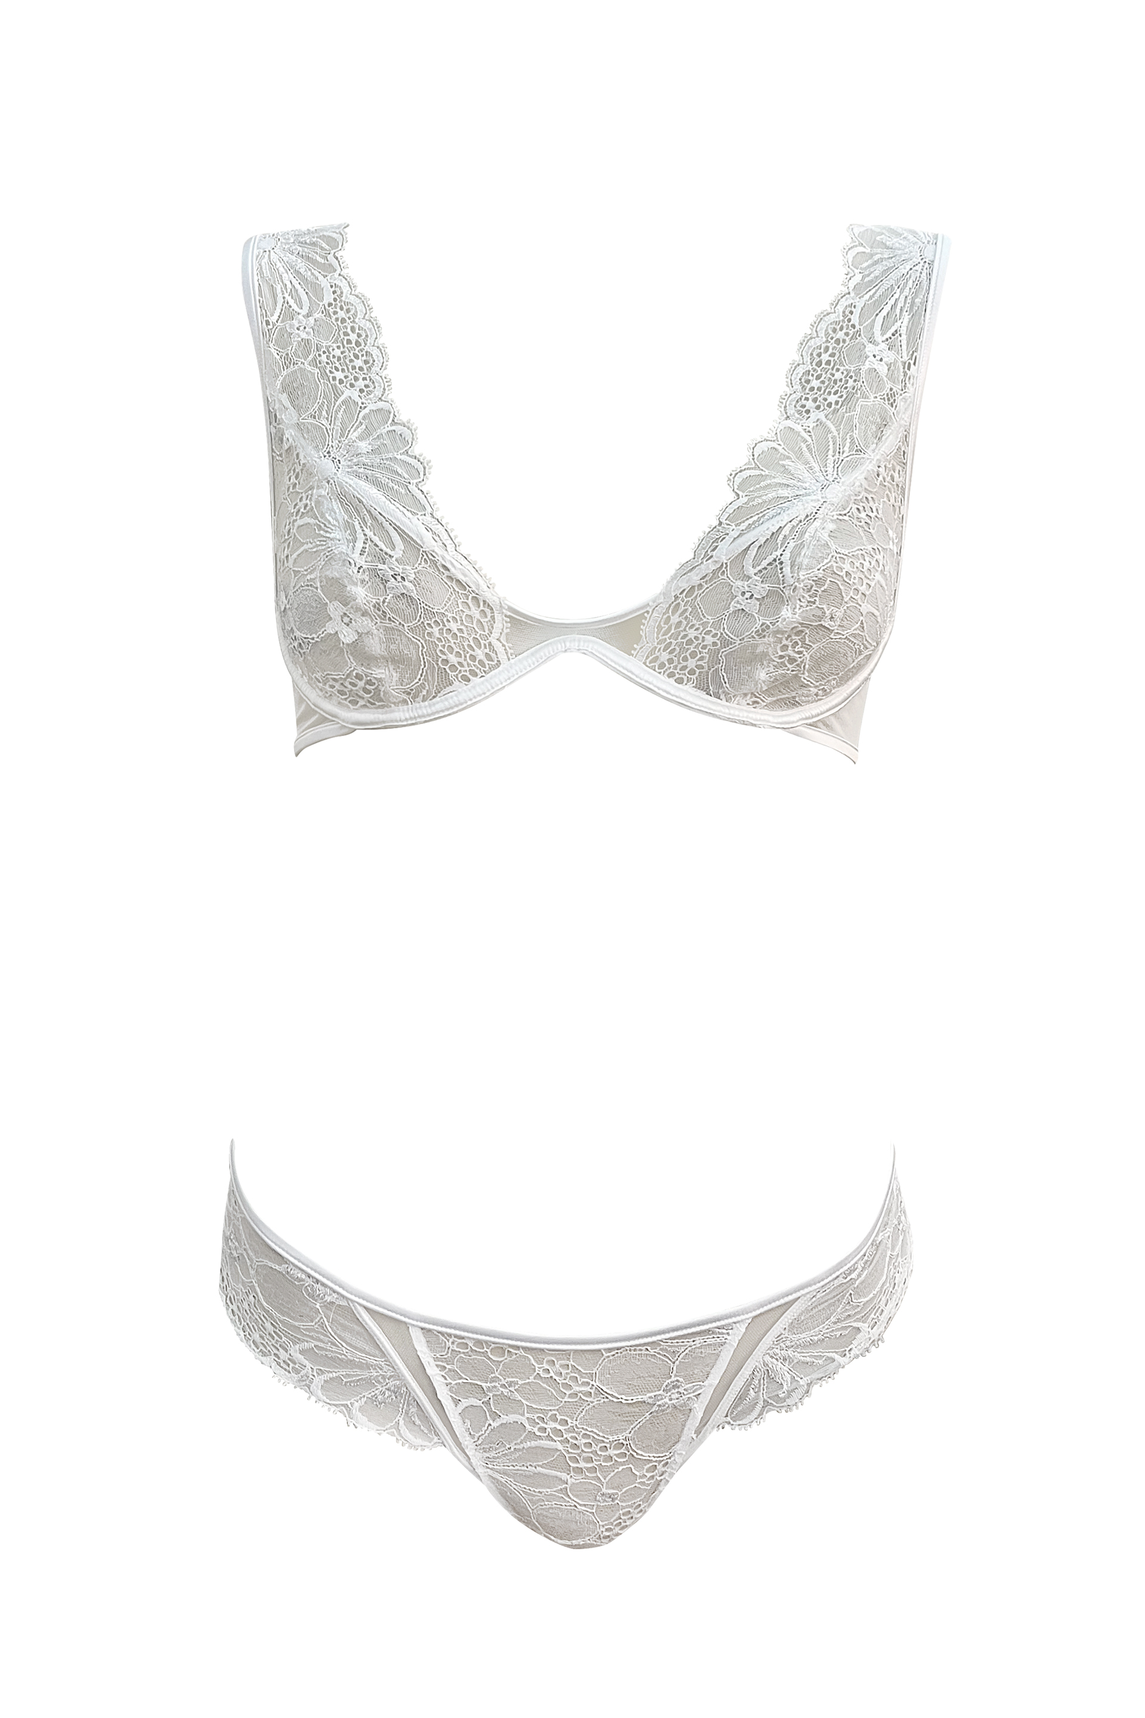
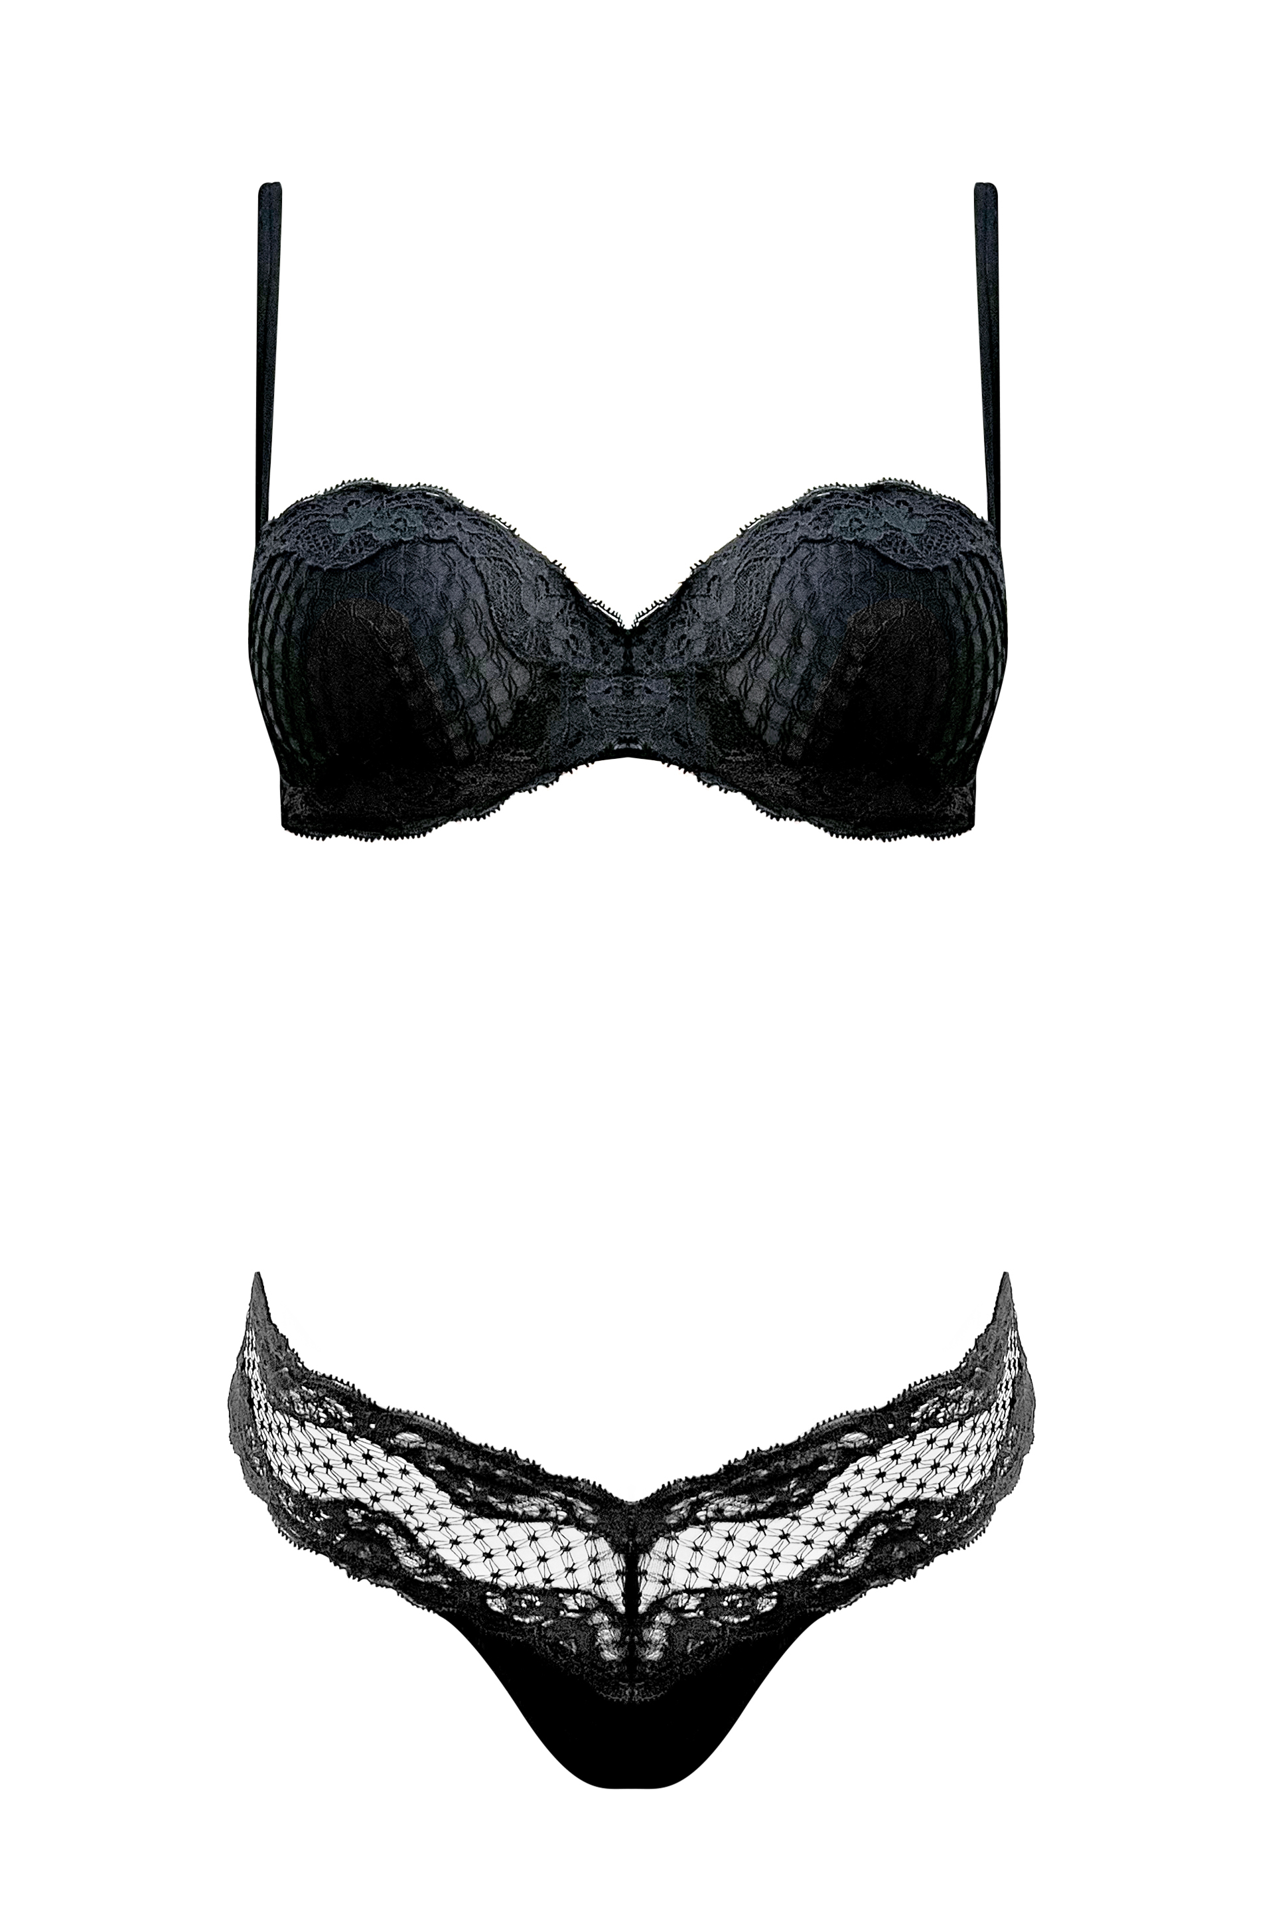
Deliveries
2 DECEMBER | 22 JANUARY | 12 FEBRUARY
ANDRAOS | OXMAN | LONG
ZAHA | TYNG | EDEN ROCK

Slide 3
Hero
ZAHA FLORIDA 360º Campaign

Slide 4
LINGERIE BIDS
SPRING/SUMMER 2023

